Slide 1
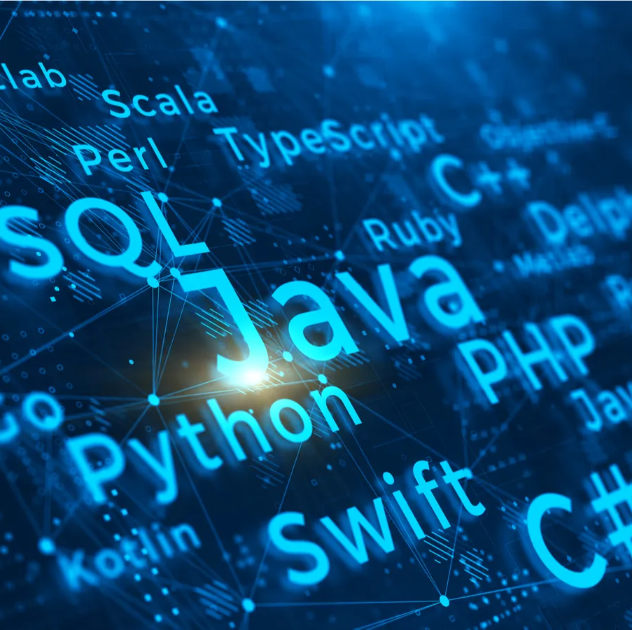
Geographical Representation in NYT Articles
Team Members: Kossi Akplaka, Saloua Daouki

Slide 2
Introduction:
This course delved into Natural Language Processing (NLP) and its diverse applications, such as sentiment analysis and spam detection. This project aims to extend our understanding of NLP, specifically focusing on Named Entity Recognition (NER).
Notes:
One of the skills that we got the basics of, and Kossi and I wanted to acquire more of is

Slide 3
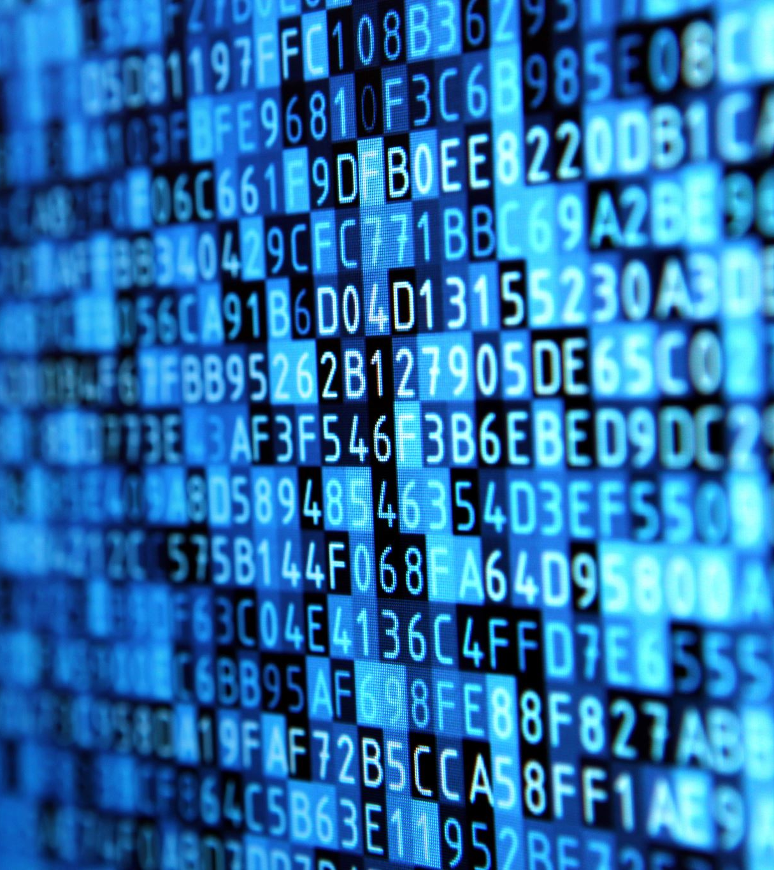
Natural Language Processing
Definition: NLP focuses on the interaction between computers and humans using natural language.
Objective: The ultimate objective of NLP is to enable computers to understand, interpret, and generate human language in a way that is both meaningful and contextually relevant.
Applications of NLP:
Sentiment Analysis, Spam Detection
Named Entity Recognition, Language Translation, Text Classification, Speech Recognition, Chatbots, etc..
Notes:
In this project, We are going to use one of the NLP applications; Named Entity Recognition (NER)

Slide 4

Named Entity Recognition (NER)
Definition: Involves identifying and classifying named entities (such as names of people, organizations, locations, dates, etc.) within an unstructured text.
Applications:
Search Engine Optimization: Assist search engines in understanding the content of web pages better. Improve the accuracy of the results.
Social media content: Identifies entities to understand discussions, trends, and sentiments.
Customer Support and Chatbots: Extract entities to provide more context-aware and relevant responses.

Slide 5
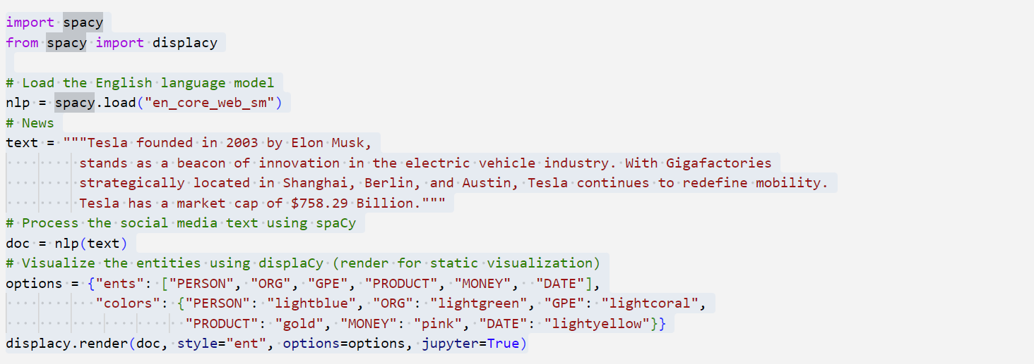
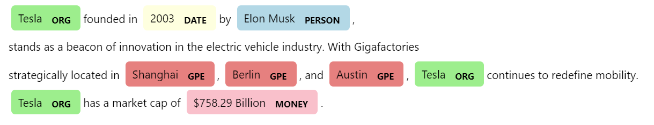
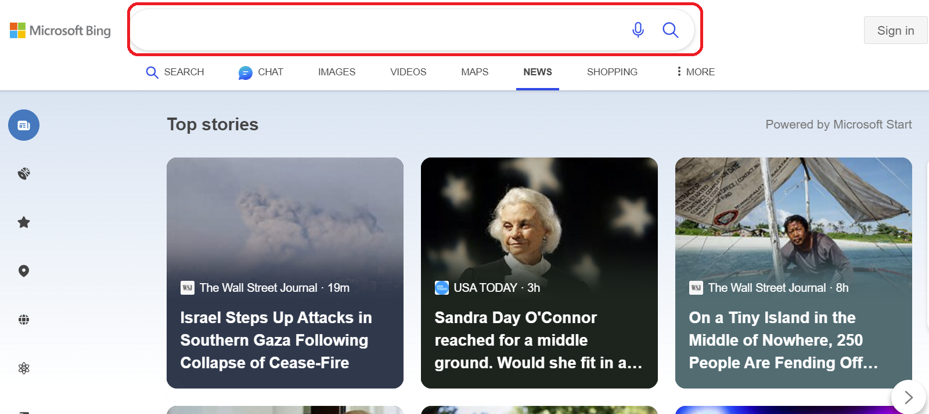
Application 1: Search Engine Optimization (spaCy)

Slide 6
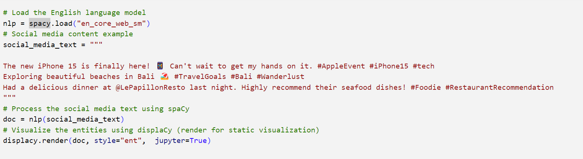
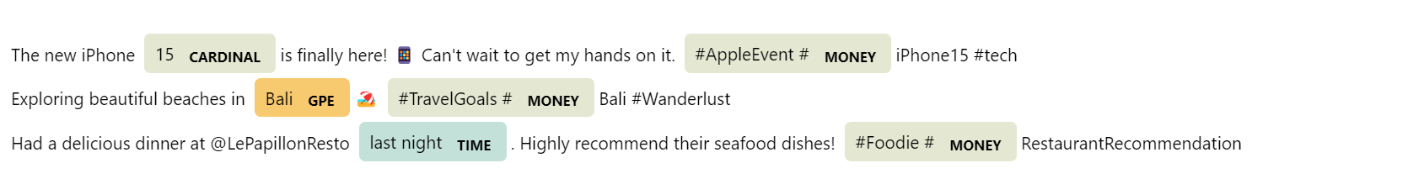
Application 2: Social Media Content Curation

Slide 7

Limitations of Named Entity Recognition (NER)
Training dataset: NER models are typically trained on specific datasets, and they may not recognize entities that are not present in their training data.
Handling Noise: NER models can be sensitive to noise and may misinterpret text with spelling errors, abbreviations, or non-standard language.

Slide 8
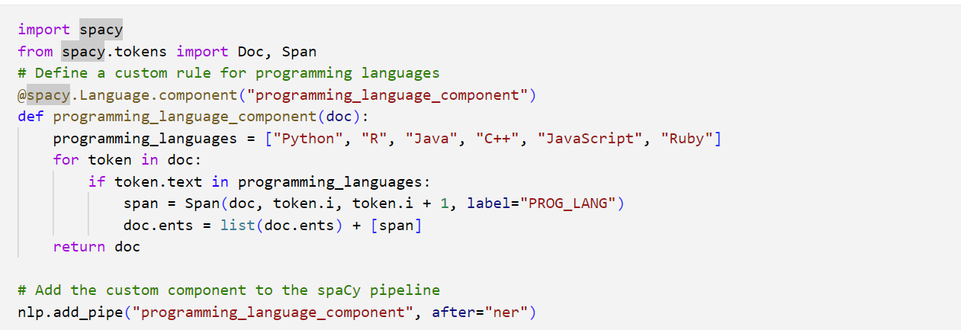
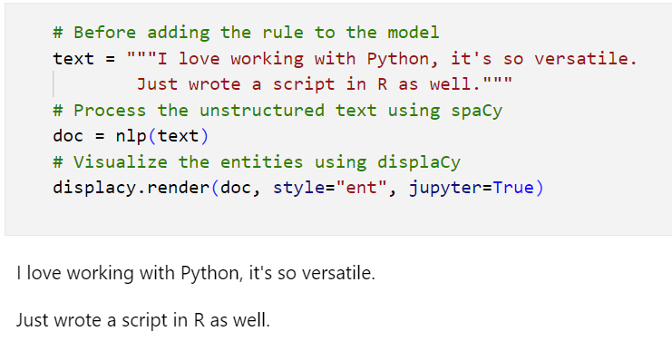
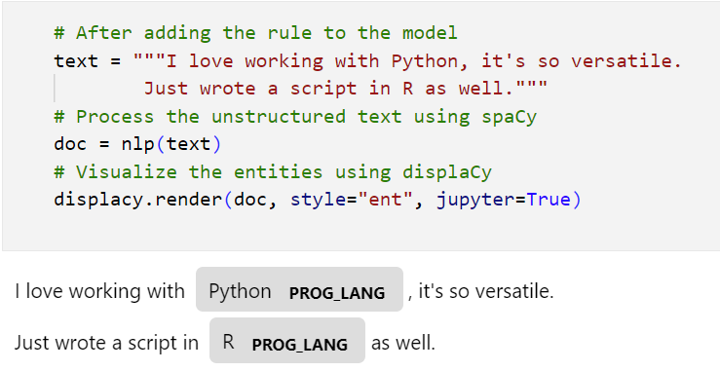
Overcoming NER Limitations
1. Customize NER models by adding a rule.
2. Leverage Large Language Models like GPT from Open-AI

Slide 9
Research Question
How has the New York Times covered different regions of the world in 2023?
Notes:
After exploring the applications and limitations of NER models, let's get a metadata from New York Times articles. The goal is to answer the research question:

Slide 10
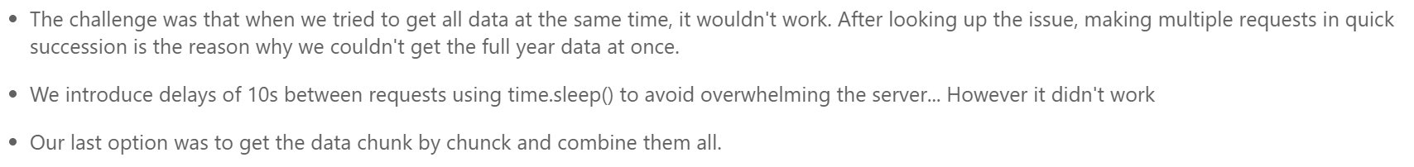
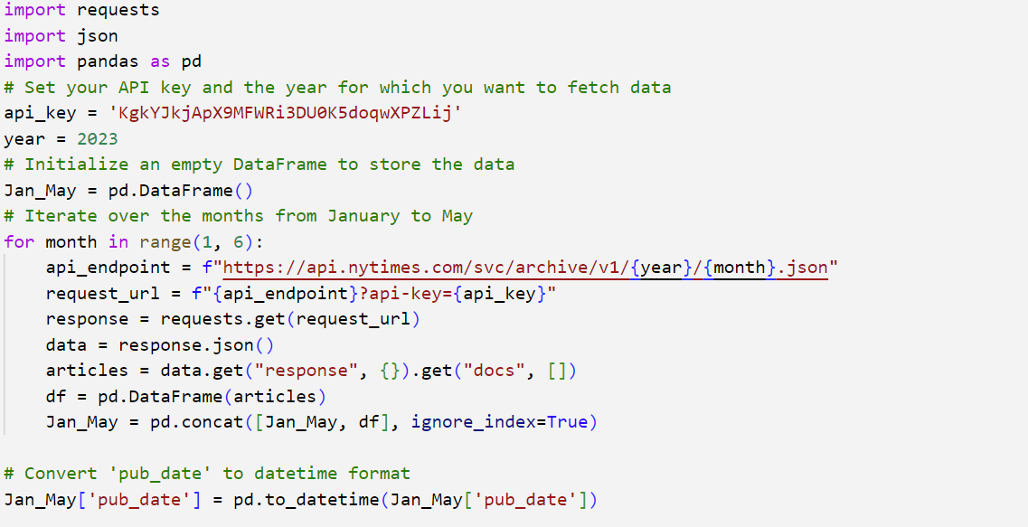
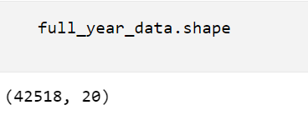
Get the data from NYT times API
Notes:
To answer the research question, we downloaded the metadata of 2023 from January to November using this code:
After storing the data into a dataframe, we got 20051 rows and 20 columns.

Slide 11
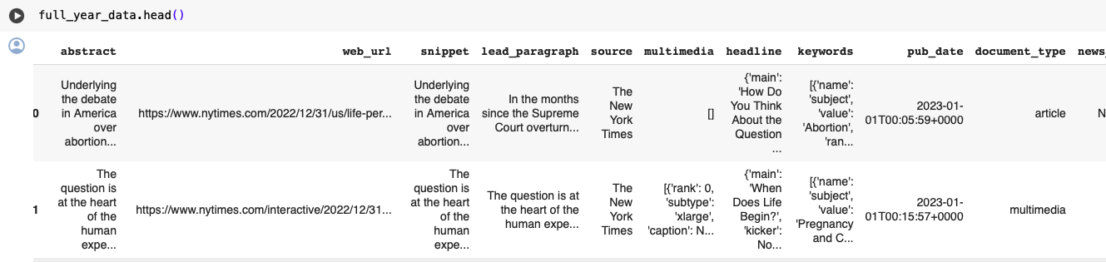
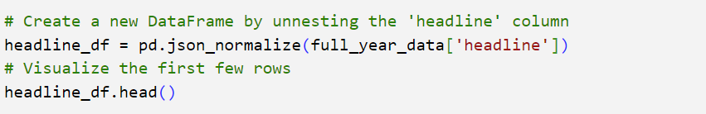
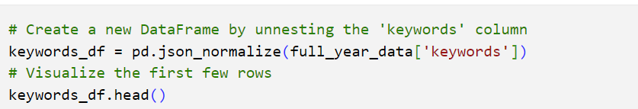
Tidying the data
Notes:
To be able to analyze the data, we need to tidy it. The first thing is to unnest the columns keyword and headline (since it contains lists)

Slide 12
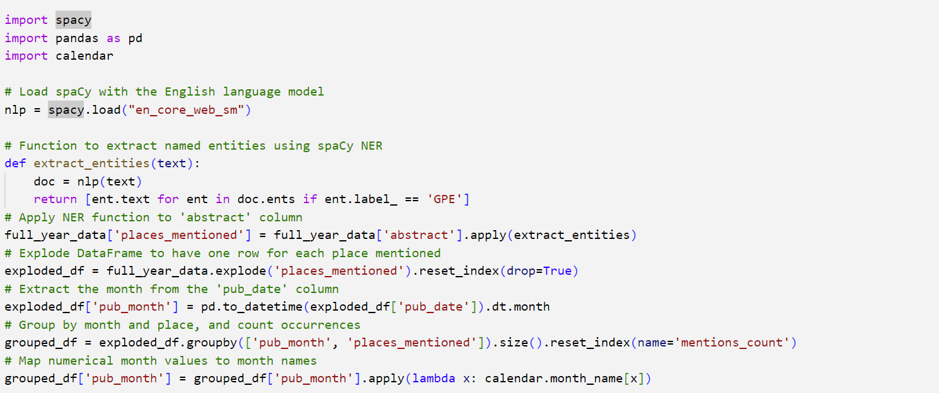
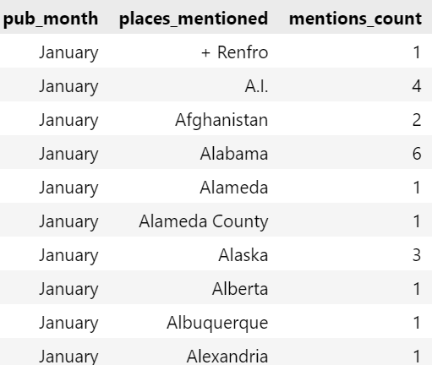
Using spaCy model to answer the research question
Notes:
In this code, we extracting the places mentioned from the abstract column and the month from the date of publication. Then, create a subset that contains the month, the places and the number of times each place was mentioned

Slide 13
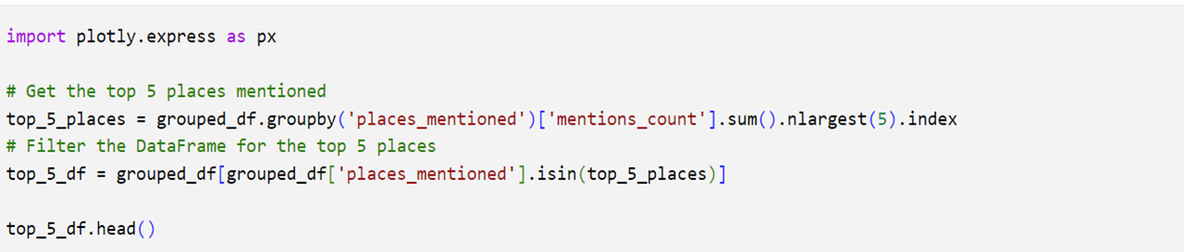
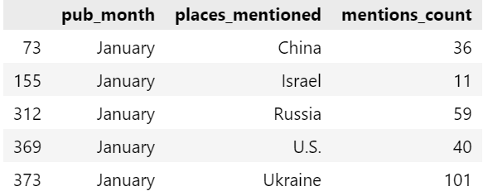
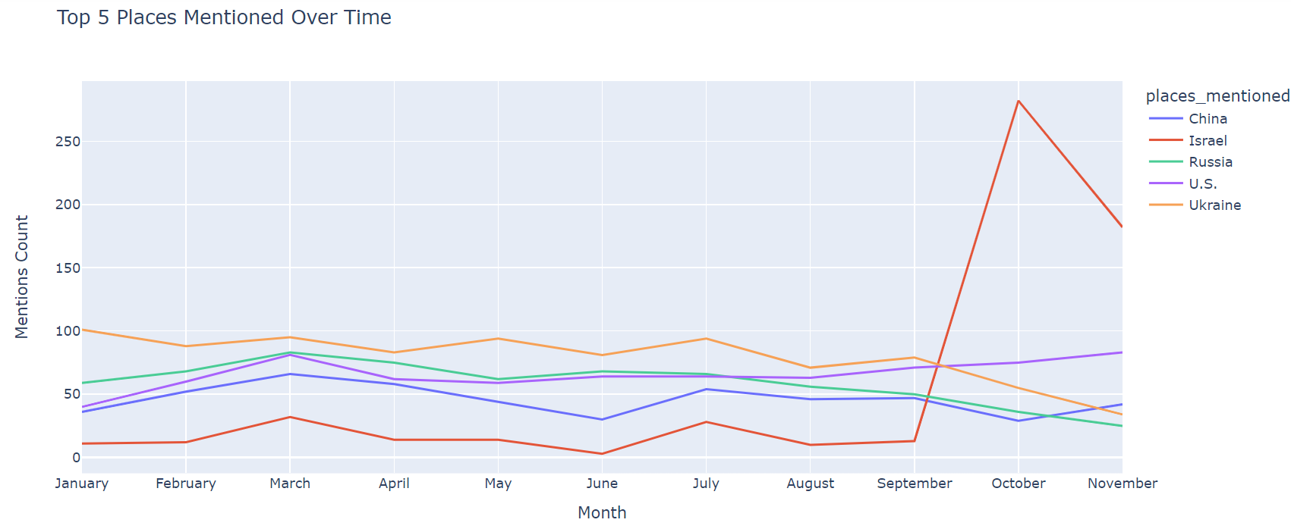
Top 5 placed mentioned over time

Slide 14
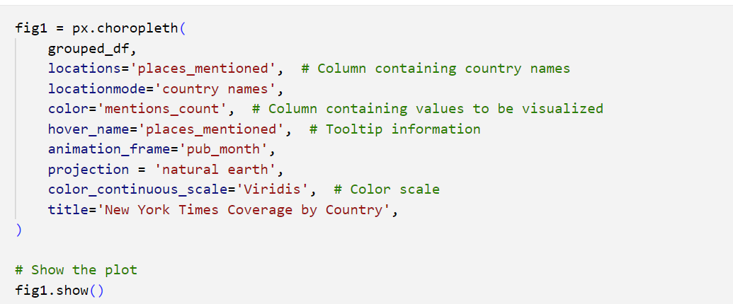
Visualization of the New York Times Coverage 2023
Notes:
To visualize the New York Times Coverage, we used choropleth from plotly express to create an interactive earth map based on the number of the occurrences of each place for every month from January to November

Slide 15
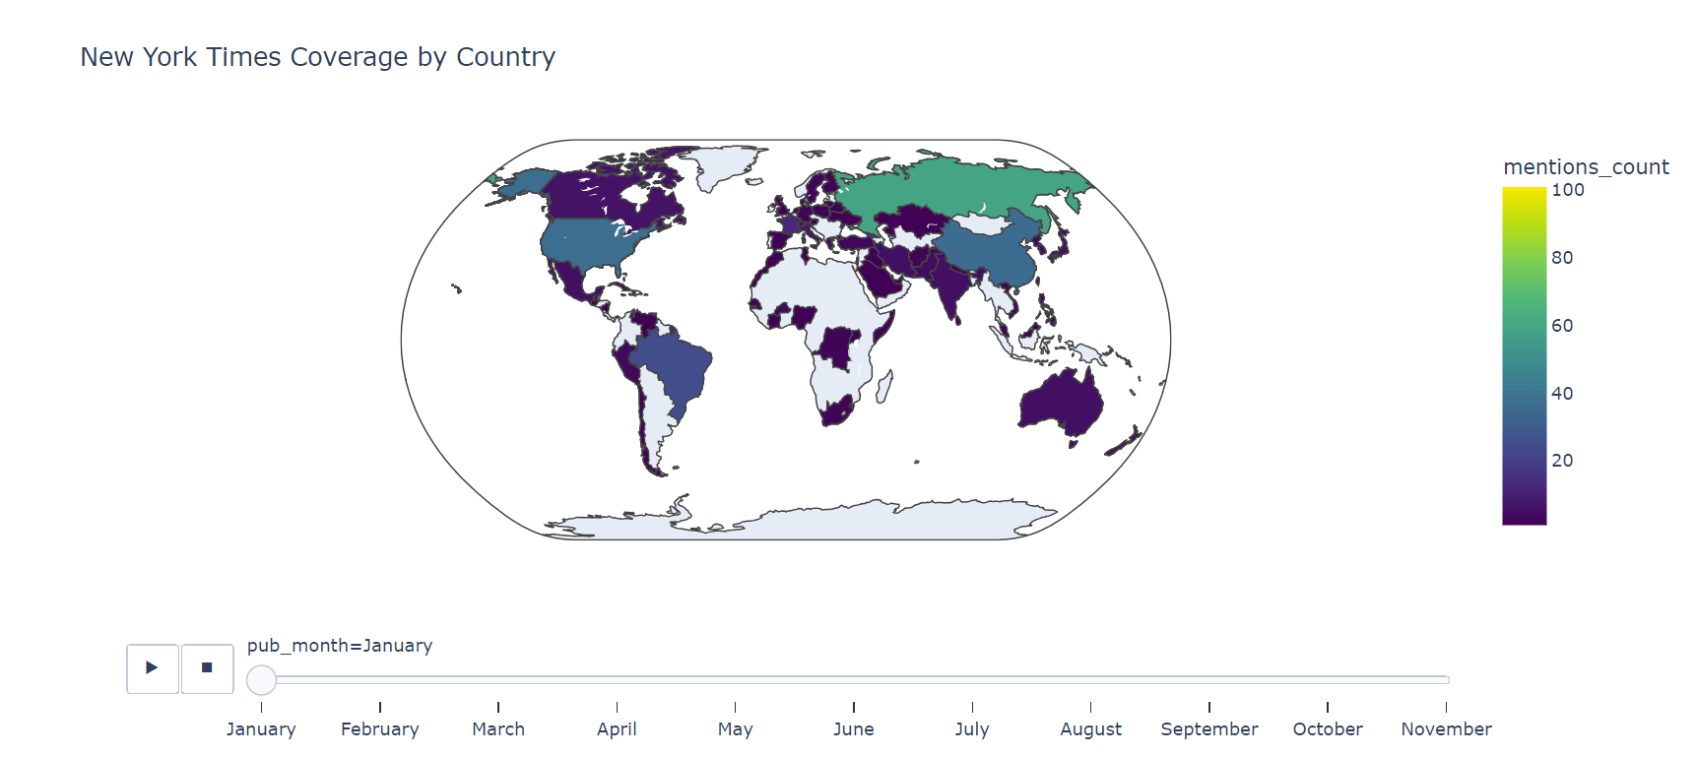

Slide 16
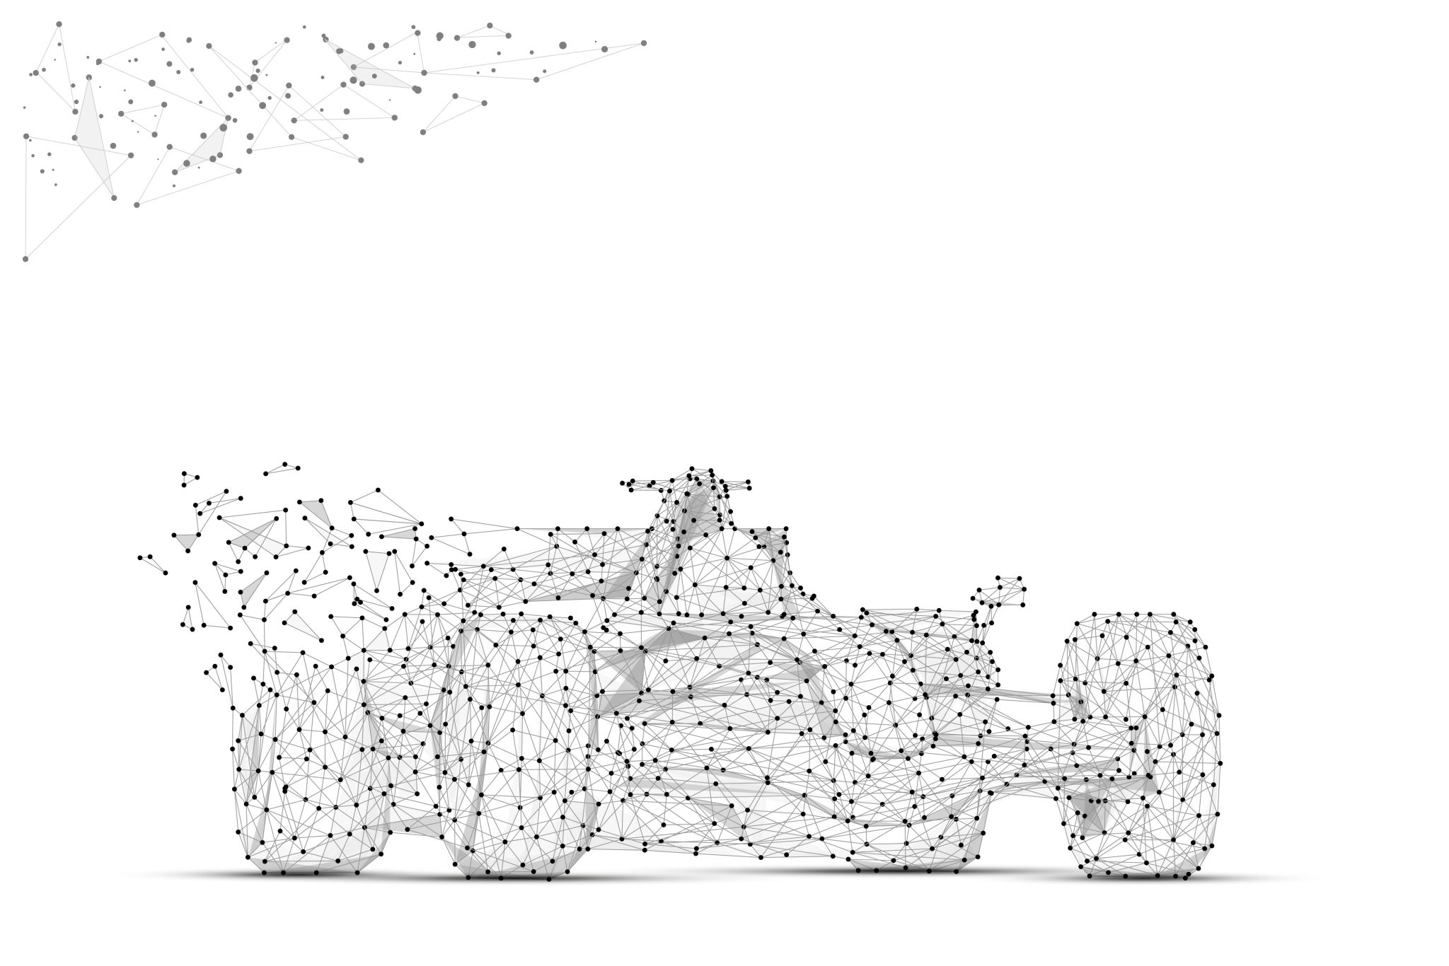
Hugging Face Transformers (BERT)
Definition: BERT (Bidirectional Encoder Representations from Transformers) is a transformer-based language model architecture.
BERT is designed to help computers understand the meaning of ambiguous language in text by using surrounding text to establish context. (TechTarget)

Slide 17
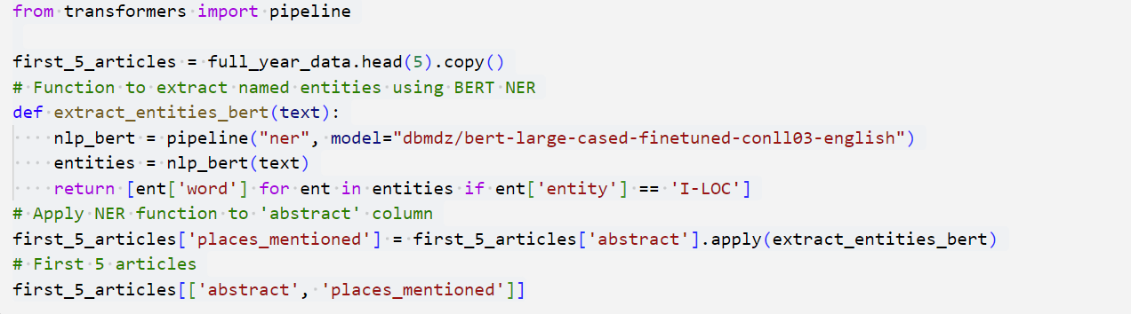
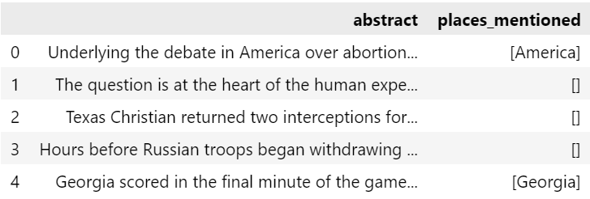

Answer the research question using BERT transformers

Slide 18
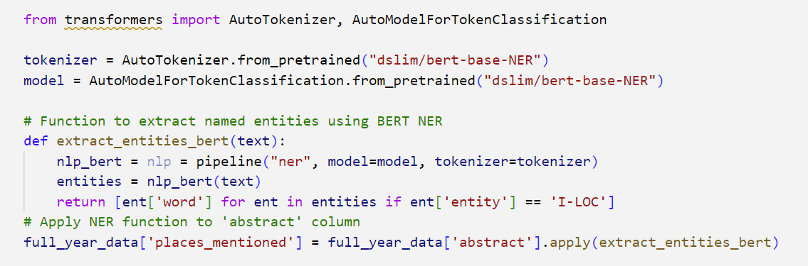
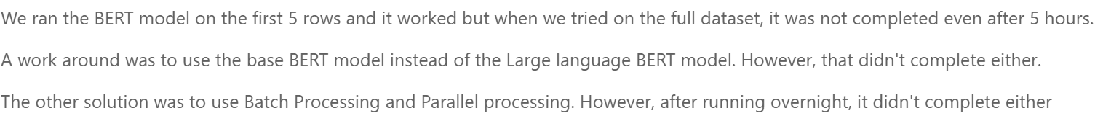
Generalization of the BERT model for the full dataset

Slide 19
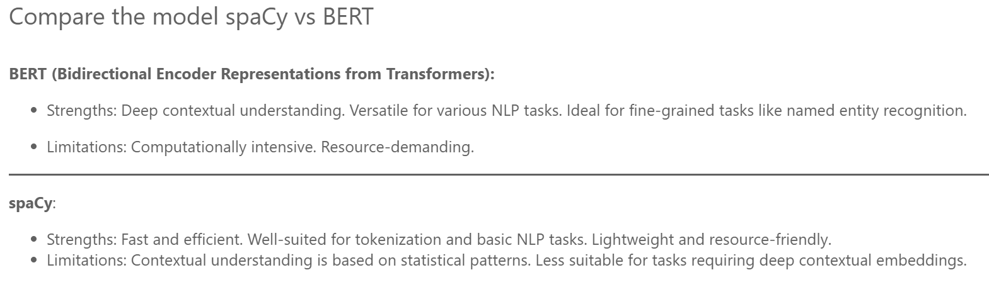

Slide 20
Summary:
In summary, the New York Times coverage reflects a combination of global events, regional conflicts, and geopolitical tensions, with an emphasis on ongoing issues in Ukraine, Russia, the U.S., China, and Israel throughout the year. The nature of the coverage aligns with major international events and conflicts shaping the geopolitical landscape.

Slide 21

Conclusion
NER Capabilities: Identifies and categorizes entities, aiding in information extraction from unstructured text.
Project Relevance: Enhances understanding of news articles by pinpointing key entities and supporting geographic analysis.
NER Limitations: Faces challenges in handling ambiguous terms and complex linguistic contexts.

